Slide 1
AI Powered Crime Prediction For Cyber Application
Or Herman-Saffar
March 2018

Slide 2

What if, we could advise the police
where and when
to allocate their resources, in order to prevent future crimes?

Slide 3
Outline
Motivation
Predicting future crimes
Exploring the Crimes in Chicago dataset
Feature extraction- what could help us predict future crimes?
Prediction model- Training
Prediction model- Evaluation
Conclusions

Slide 4
Motivation- Cyber Attack Prediction
Goal- make predictions about future cyber attacks
Which data we need to collect?
Characteristics
Historical data
Records amount
Informative features
Time resolution

Slide 5
Motivation- Cyber Vs. Crime Prediction
Goal- make predictions about future crimes
Similarities between Cyber and Crime domains:
Cyber Domain | Crime Domain
Cyber attack category | Crime category
Timely information | Timely information
Organizational sector | Geographical region
Why Crimes in Chicago dataset?

Slide 6
Predicting Future Crimes

Slide 7
Predicting Future Crimes
What do we want to predict?
Crime Count
Crime Type (what)
Day (when)
Police District (where)
to help the police understand how to allocate their resources

Slide 8
Predicting Future Crimes
Data Science Project Life Cycle
Exploratory Data Analysis
Feature Extraction
Model
Evaluation
Modeling

Slide 9

Outline
Motivation
Predicting future crimes
Exploring the Crimes in Chicago dataset
Feature extraction- what could help us predict future crimes?
Prediction model- Training
Prediction model- Evaluation
Conclusions

Slide 10

Exploring the Crimes in Chicago Dataset
Rows | Columns | Each row is | Years
6.48M | 22 | Reported crime | 2001 to present
ID | Date | Primary Type | Description | Location Description | Arrest | Police District | Location
11148574 | 11/13/2017 10:35 PM | Narcotics | Poss: cannabis <30g | Vehicle | ✓ | 009 | (41.799, -87.663)
23693 | 11/13/2017 06:15 PM | Homicide | First degree murder | Street | ✗ | 019 | (41.967, -87.661)
11147792 | 11/13/2017 09:48 AM | Theft | Retail theft | Small retail store | ✗ | 001 | (41.878, -87.633)

Slide 11


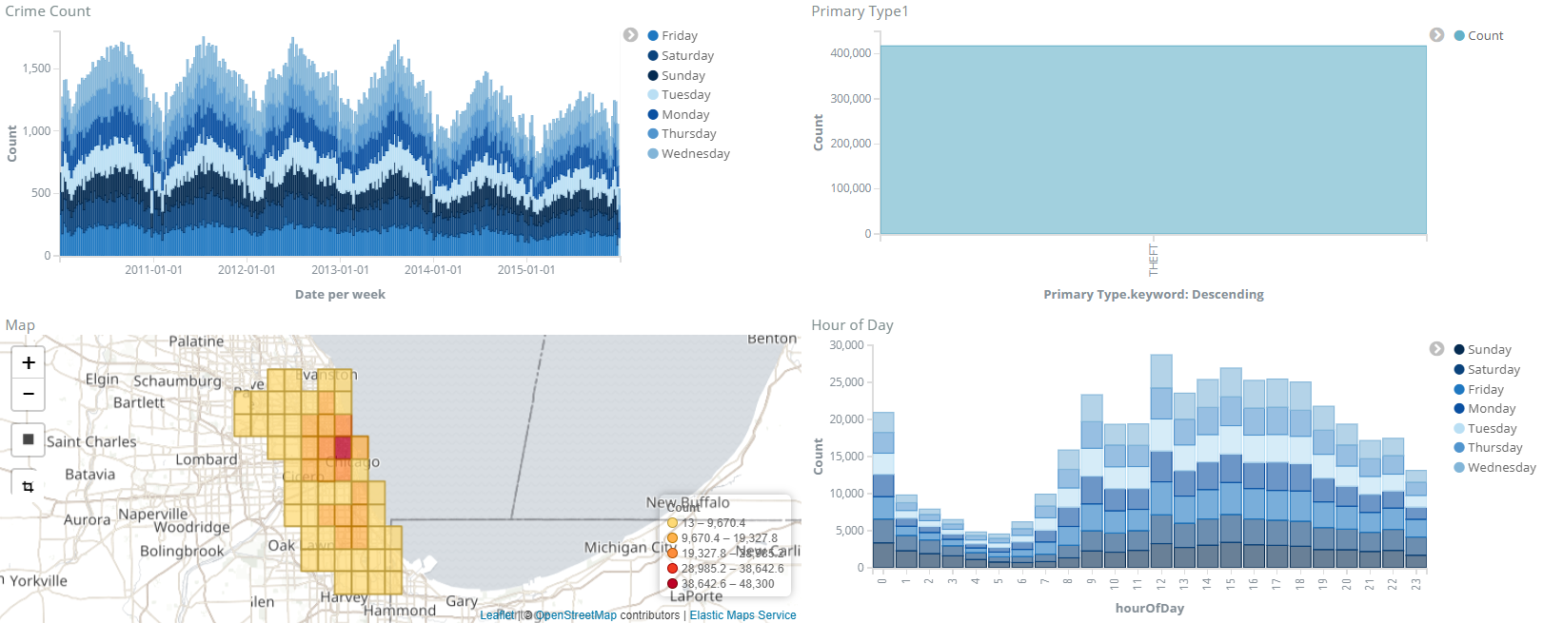
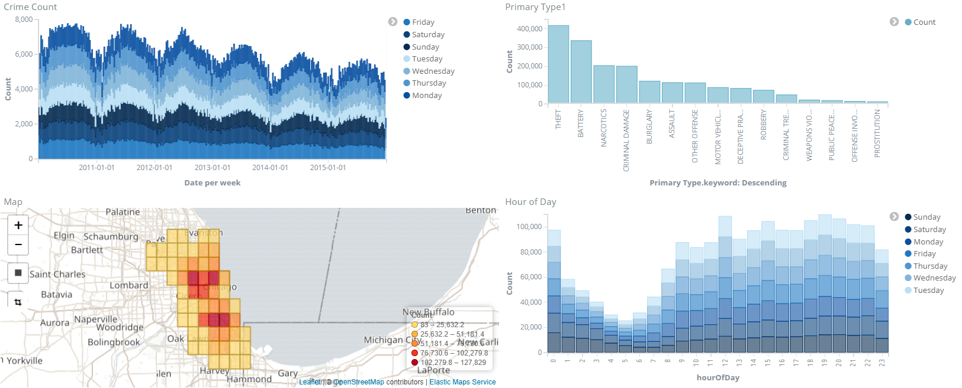

Exploring the Crimes in Chicago Dataset
Crime Count
Primary Type
Count
Count
Map
Week
Hour
Primary Type
Count
Hour

Slide 12
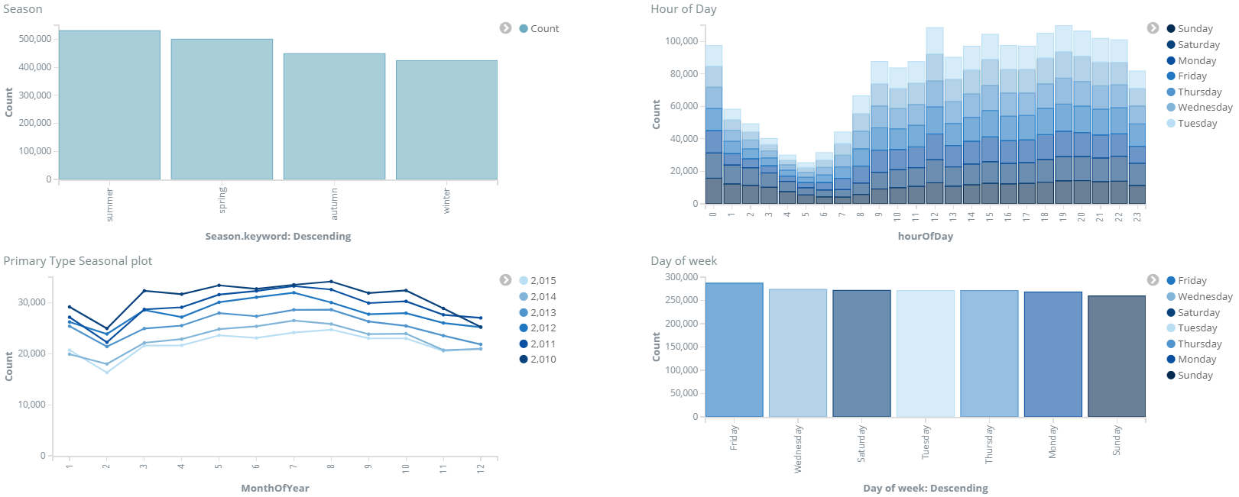
Exploring the Crimes in Chicago Dataset
Season
Hour
Count
Count
Month
Season
Day of Week
Hour
Count
Count
Month
Day of Week
Notes:
Theft1.0or
Prostitution7.0or

Slide 13
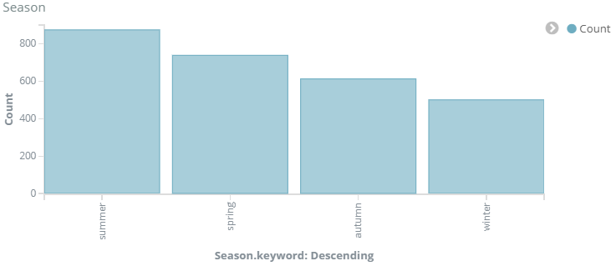
Exploring the Crimes in Chicago Dataset
Season
Homicide
Hour
Count
Count
Month
Season
Day of Week
Hour
Count
Count
Month
Day of Week
Notes:
Theft1.0or
Prostitution7.0or

Slide 14
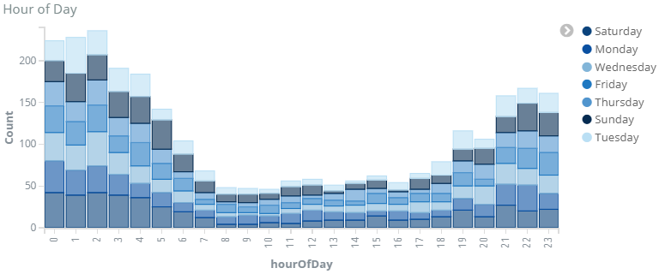
Exploring the Crimes in Chicago Dataset
Season
Homicide
Hour
Arson
Count
Count
Month
Season
Day of Week
Hour
Count
Count
Month
Day of Week
Notes:
Theft1.0or
Prostitution7.0or

Slide 15
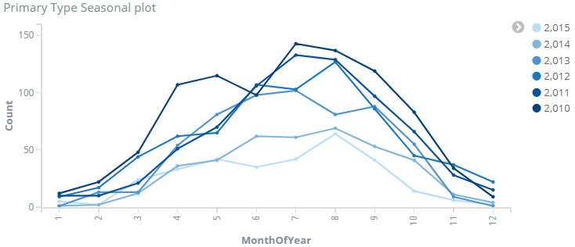
Exploring the Crimes in Chicago Dataset
Season
Homicide
Hour
Arson
Count
Count
Month
Season
Day of Week
Hour
Gambling
Count
Count
Month
Day of Week
Notes:
Theft1.0or
Prostitution7.0or

Slide 16
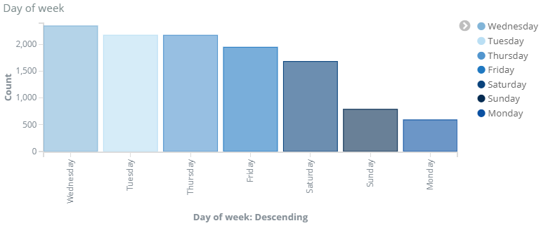
Exploring the Crimes in Chicago Dataset
Season
Homicide
Hour
Arson
Count
Count
Month
Season
Day of Week
Hour
Gambling
Prostitution
Count
Count
Month
Day of Week
Notes:
Theft1.0or
Prostitution7.0or

Slide 17

Outline
Motivation
Predicting future crimes
Exploring the Crimes in Chicago dataset
Feature extraction- what could help us predict future crimes?
Prediction model- Training
Prediction model- Evaluation
Conclusions

Slide 18
Feature Extraction
What could help us predict future crime counts?
Season
Month
Day of week
Day of month
Weather- temperature
Holidays
Is-weekend

Slide 19

Outline
Motivation
Predicting future crimes
Exploring the Crimes in Chicago dataset
Feature extraction- what could help us predict future crimes?
Prediction model- Training
Prediction model- Evaluation
Conclusions

Slide 20
Prediction Model
Linear Regression
Linear Regression- a linear approach for modeling the relationship between a scalar dependent variable and one or more explanatory variables.
Dependent Variable
Crime Count
Explanatory Variables
Extracted Features

Slide 21

Outline
Motivation
Predicting future crimes
Exploring the Crimes in Chicago dataset
Feature extraction- what could help us predict future crimes?
Prediction model- Training
Prediction model- Evaluation
Conclusions

Slide 22
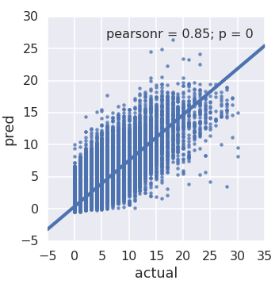
Prediction Model
Evaluation Measures
Predicted Vs. Actual values
Each point: Crime count
Crime type
Day
Police district

Slide 23
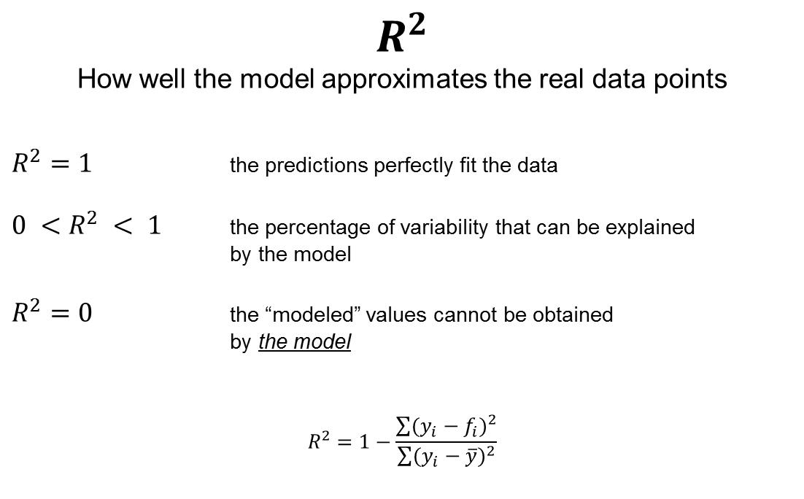
Prediction Model
Evaluation Measures

Slide 24
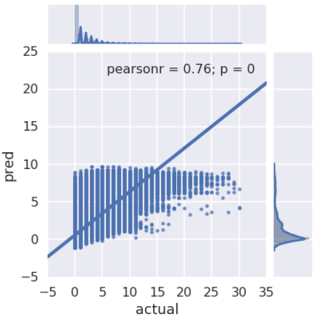
Prediction Model
Preliminary results
Test set : 0.565
Train set : 0.573

Slide 25
Outline
Motivation
Predicting future crimes
Exploring the Crimes in Chicago dataset
Feature extraction- what could help us predict future crimes?
Prediction model- Training
Prediction model- Evaluation
Conclusions

Slide 26
Feature Extraction
Time - Series related features
?
?
?

Slide 27
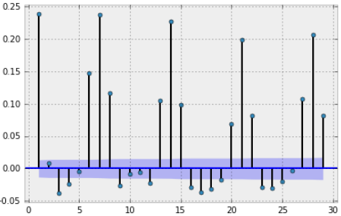
Feature Extraction
Time - Series related features
Autocorrelation-
the correlation of the signal with a delayed copy of itself, as function of delay
Correlation
Lag [days]
7 days
14 days
21 days
28 days

Slide 28
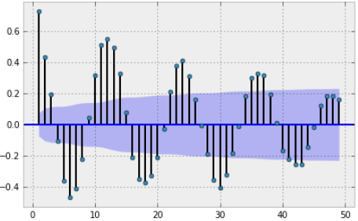
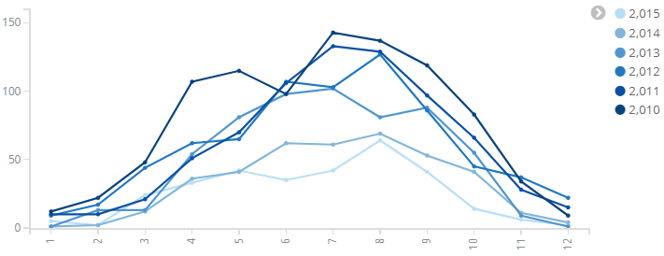
Feature Extraction
Time - Series related features
Autocorrelation-
the correlation of the signal with a delayed copy of itself, as function of delay
Gambling Autocorrelation
Gambling Counts
Correlation
Count
Lag [months]
Month
12 months
Notes:
Gambling11.0or

Slide 29
Feature Extraction
What could help us predict future crime counts?
Season
Month
Day of week
Day of month
Weather- temperature
Holidays
Is-weekend
New features:
Crime Counts of:
7 days before
14 days before
21 days before
28 days before
1 year before

Slide 30
Outline
Motivation
Predicting future crimes
Exploring the Crimes in Chicago dataset
Feature extraction- what could help us predict future crimes?
Prediction model- Training
Prediction model- Evaluation
Conclusions

Slide 31
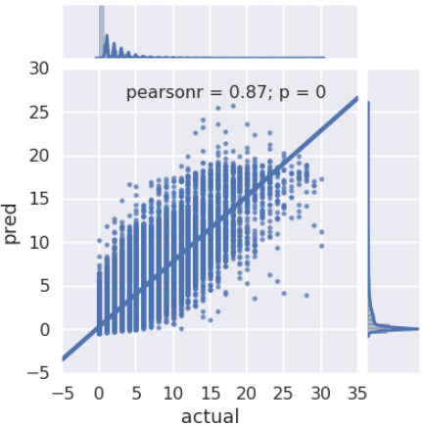
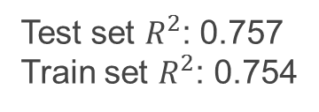

Prediction Model
Results
Time-Series Features
Results
Preliminary
Results

Slide 32
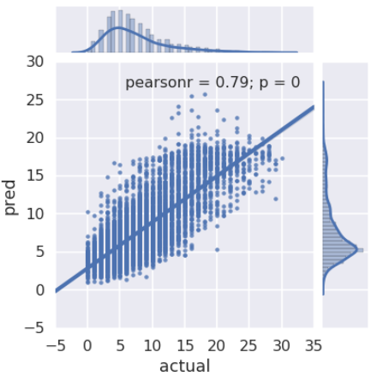

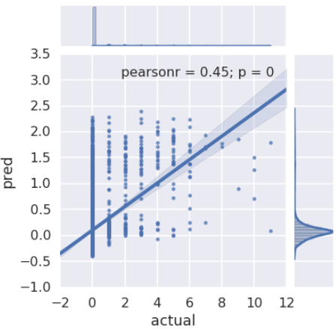

Prediction Model
Results
Theft
Prostitution
Notes:
Prostitution OR Narcotics ?
Another slide for bad crime ?

Slide 33

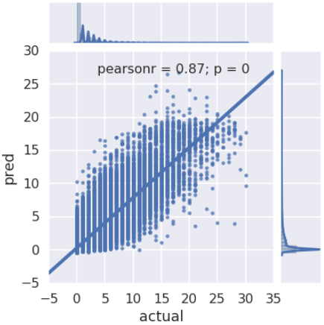

Prediction Model
Train \ Test Splitting
Train 2014-2015
Test 2016
Train 2012-2015
Test 2016

Slide 34
Outline
Motivation
Predicting future crimes
Exploring the Crimes in Chicago dataset
Feature extraction- what could help us predict future crimes?
Prediction model- Training
Prediction model- Evaluation
Conclusions

Slide 35
Conclusions- Cyber Domain
Predictions depend on the crime type
Training data- as much as we can?
Time window- depends on the amount of crimes
Autocorrelation to find significant lags

